Slide 1
PROPAGANDA-The Ultimate Art of Persuasion and Deception
Are You Brainwashed?

Slide 2
Propaganda
A specific type of message or presentation aimed at serving an agenda (changing minds or opinions)
One can read messages from pictures or symbols
Designed to influence people’s opinions through:
Persuasive messages
Political messages
Religious messages
Moral messages
Advertising
Slogans

Slide 3
Quotes
By the skillful and sustained use of propaganda, one can make people see even heaven as hell or an extremely wretched life as paradise.
Adolf Hitler
There are a lot of lies going around... and half of them are true.
Winston Churchill

Slide 4
Techniques or Methods Used in Propaganda
Name-calling ties a person or cause to a largely perceived negative image
Common Name Calling:
Commie
Fascist
Pig
Yuppie
Bum
Terrorist
Sell-out
Radical
Socialist

Slide 5
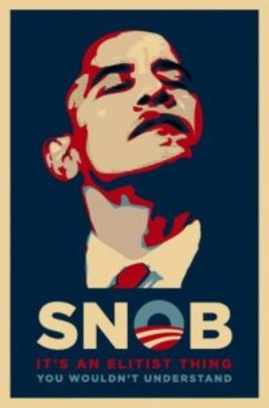
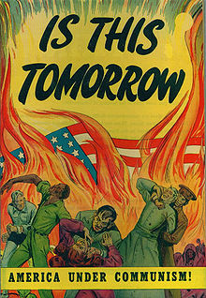
Name Calling/Loaded Words examples

Slide 6
2. Glittering Generality
Opposite of name-calling; associates someone or something with a positive image
Uses lofty or fancy language (honor, glory, love of country, etc.)
Words used demand approval without thinking
An ad by a cigarette manufacturer proclaims to smokers: Don’t let them take your “rights” away!
Implied greater loss than will really occur
“Defenders of Democracy”
“Axis of Evil”

Slide 7
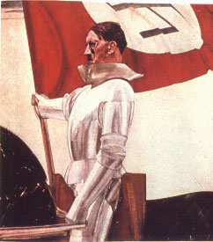
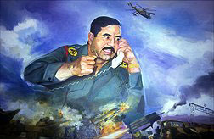
Glittering Generality examples

Slide 8
3. Simplification (or Stereotyping):
Making the problem and solutions seem more simple than they really are
Will reduce problem to a clear-cut choice involving good and evil: “You are either with us or against us”
Used to sway uneducated audiences
Often leaves out important information

Slide 9
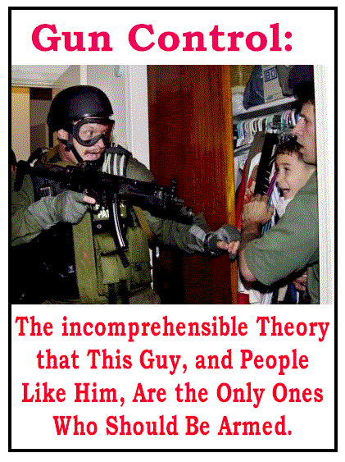
Simplification example

Slide 10
4. Transfer
Transfer employs the use of symbols, quotes, or the images of famous people to convey a message not necessarily associated with them.
Fake experts
Religious symbols
Flags
“Scientists” in white coats seeming like experts on a cause
Associating Democrats with terrorism (pictures of bin Laden and World trade center attacks) or Republicans with anti-immigration (images of the Berlin Wall)
Freedom fighters (really terrorists)

Slide 11
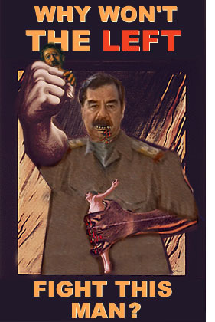
Transfer

Slide 12
5. Testimonial
This is celebrity endorsement of a product, philosophy, movement, or candidate
Professional athletes, famous business people, etc
Can be in or out of context
Can be misquoted to serve a cause

Slide 13
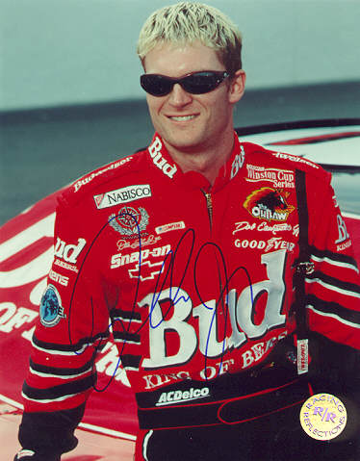
Testimonial example

Slide 14
6. Plain Folks
Here the candidate or cause is identified with the common people from everyday walks of life.
The idea is to make the candidate/cause come off as grass roots and all-American
Like “Every Man”
EX: Politicians eating at the local diner

Slide 15
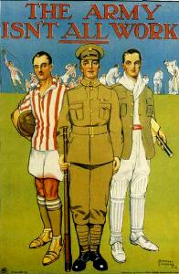
Plain Folks example

Slide 16
7. Euphemism
Sugar coating the truth
shell shock (WWI)
combat fatigue (WWII)
Post-traumatic stress disorder (Vietnam to present)
or
“friendly fire” for killing one’s own troops
a missile as a “peace-keeper”
murder as “liquidation”
civilian casualties as “collateral damage”

Slide 17
Euphemism example

Slide 18
8. Card Stacking
Selective omission
Leaves out information
Censorship
It involves only presenting the information that is positive to an idea or proposal while omitting information contrary to it
Cigarettes are made from 100 percent natural tobacco
A politician just happens to be in town when a new school is opening - so they just drop in,
hijacking the press for their own means

Slide 19
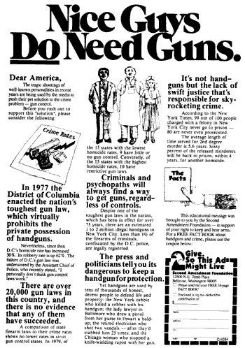
Card Stacking Example

Slide 20
9. Band Wagon
The basic idea behind the bandwagon is just that, “getting on the bandwagon”
The propagandist, advertiser, politician, or arguer puts forth the idea that everyone else is doing this, or everyone else supports this idea/person/cause, and SO SHOULD YOU!

Slide 21
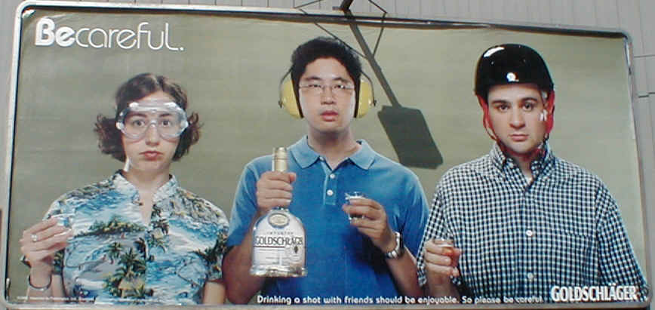
Bandwagon Example

Slide 22
10. Fear/Emotional Appeal
The idea is to present the dreaded circumstance and usually follow it up with the kind of behavior needed to avoid or prevent that horrible event
EX: If you don’t smoke, many companies will go broke, the economy will fail, the terrorists will take over and steal your children. So smoke and prevent this from occurring…”

Slide 23
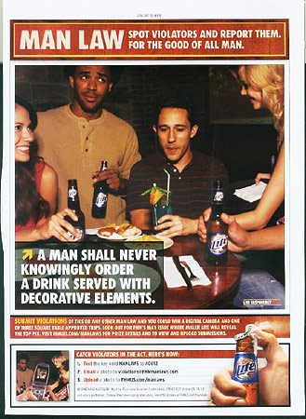
Fear/Emotional appeal examples

Slide 24
11. Logical Fallacy
When a conclusion is drawn from facts and the conclusion is not necessarily true.
Premise 1 : Bob wears boots
Premise 2: Nazis wear boots
Conclusion: Bob is a Nazi
or
Premise 1: All Christians believe in God.
Premise 2: All Muslims believe in God.
Conclusion: All Christians are Muslims
The conclusion is a twisting of logic

Slide 25
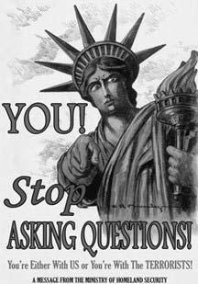
Logical Fallacy example

Slide 26
12. The power of slogans-catchy phrases to help you remember a cause or company
It's the real thing -Coca-Cola
You are in good hands with Allstate-Allstate Insurance
Just do it -Nike
Got Milk?- Dairy farmers
Oh thank Heaven for 7-11-7-11
The Breakfast of Champions-Wheaties
Your country need you-US government
An army of one-US Army
The few, the proud, the Marines-US Marines
I'm lovin' it –McDonald’s
Have it your way-Burger King
Think outside the bun –Taco Bell
R-O-L-A-I-D-S spells Relief – Rolaids
Taste the rainbow"- Skittles

Slide 27
13. LOADED Words
Similar to TRANSFER but using WORDS instead of images
Words designed to get your attention
Fighting words
Political correctness
Sensationalism

Slide 28
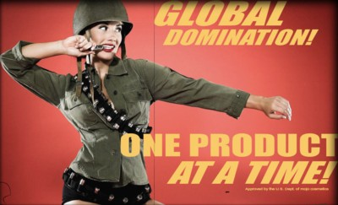

Slide 29
14. Eye appeal
Using attractive or unattractive images to persuade the target audience to act a certain way

Slide 30
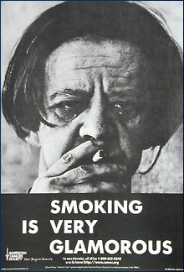
EYE APPEAL example

Slide 31
15. REPETITION
"See, in my line of work you got to keep repeating things over and over and over again for the truth to sink in, to kind of catapult the propaganda."
Repetition of words or images to get the attention and focus of the viewer

Slide 32
Repetition example

Slide 33
16. SNOB APPEAL
Appealing to the finer things in life
Often uses the “good life” as an example
Often targeted at the upper class or the wealthy in society
Reverse of BANDWAGON

Slide 34
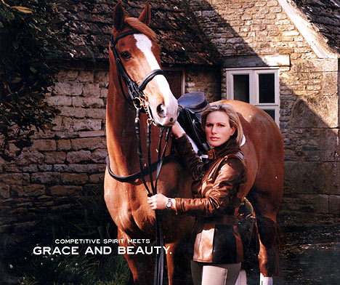
Snob Appeal example

Slide 35
17. SHOCKVERTISING
From “shocking” and “advertising”
Using shocking images or words to get attention of people
Can be offensive, graphic (gory), or pornographic in nature
Can be metaphorical or symbolic in nature

Slide 36
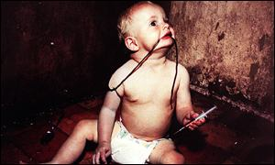
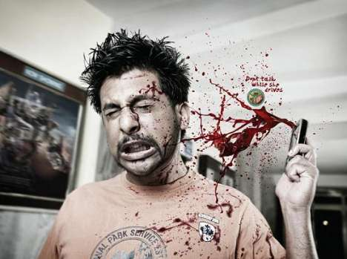
SHOCKVERTISING example

Slide 37
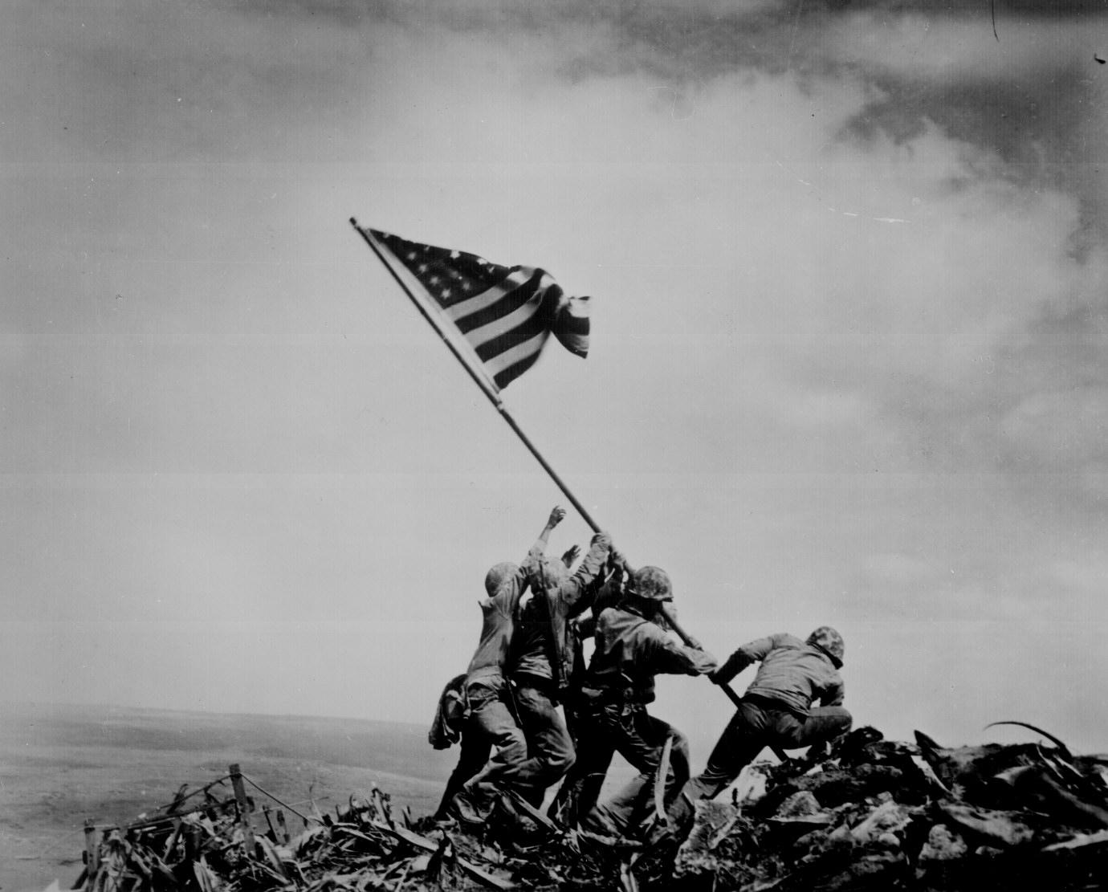
The power of symbols and images

Slide 39
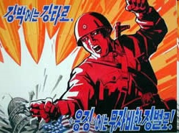

Slide 41
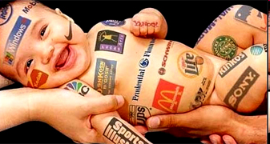
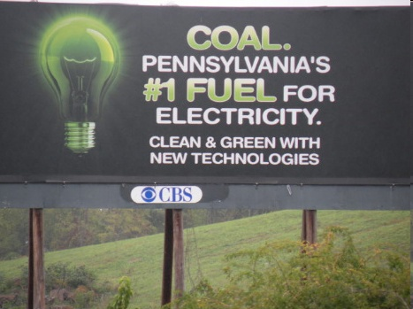

Slide 44
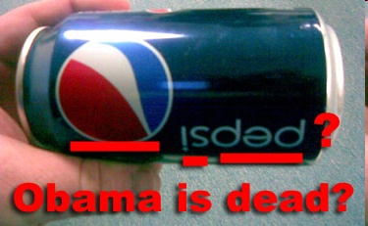
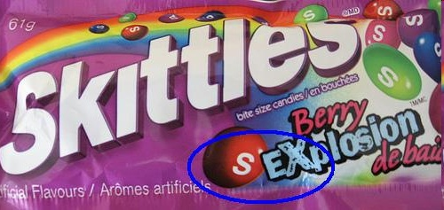

Slide 45
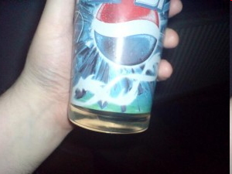
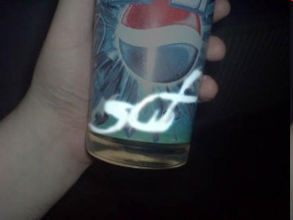

Slide 46
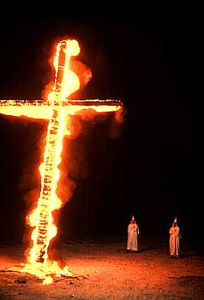
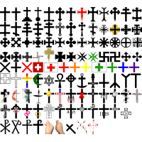
The power of symbols and images

Slide 47
The power of symbols and images

Slide 48
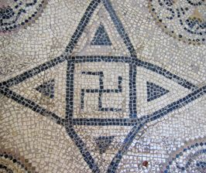

Slide 49
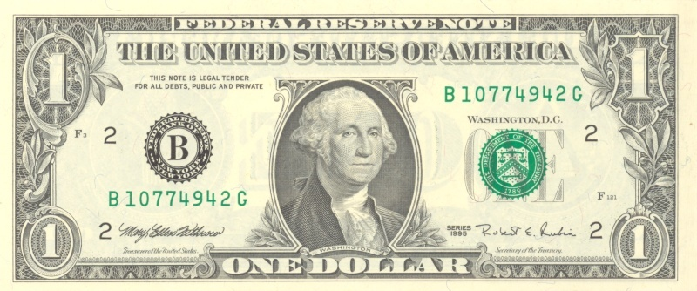
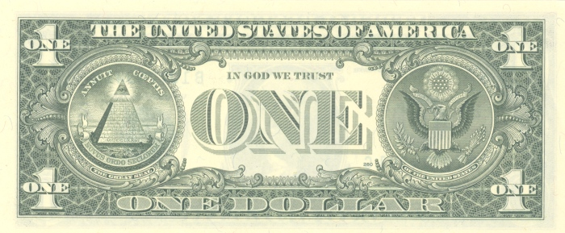
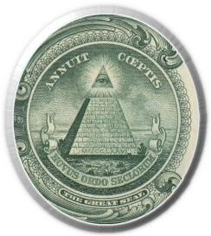
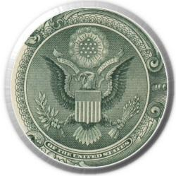

Slide 50
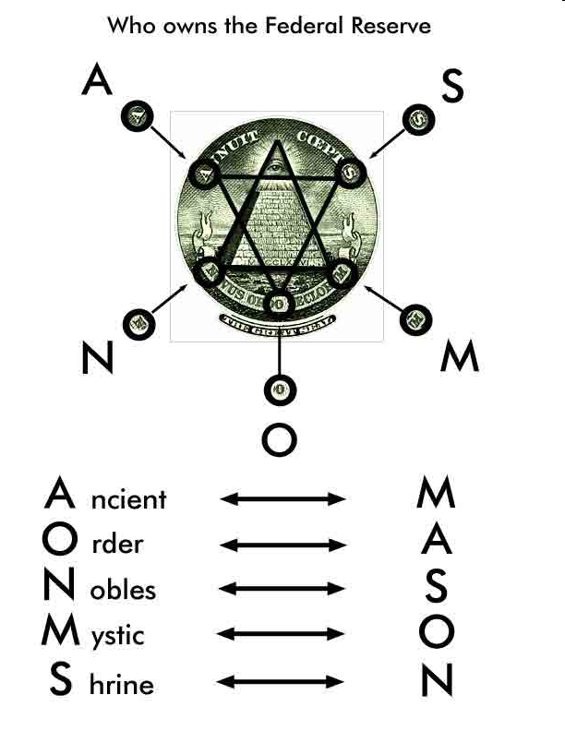

Slide 52
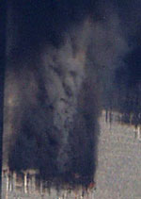
Our eyes can fool us…
I love Paris in the the springtime
The AIDS epidemic continues to focus on the the established risk groups.

Slide 53
Propaganda or Not? You Decide…

Slide 54
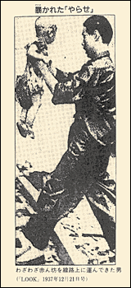

Slide 55
The power of symbols and images

Slide 56
Sample Item for Project
Description-This example is from a military t-shirt
Target audience-It is intended to promote the war to soldiers as well as to entertain the general public
Technique-This item uses a combination of transfer and euphemism.
EXPLANATION-It is transfer because it uses the American flag colors and a map of the Middle East. It uses euphemism because it tries to make war seem more fun that it really is.
Purpose-It is intended to promote war as lighthearted event as a concert by same format as a concert t-shirt. It also uses a little humor to promote war as something that is not serious of a event

